Slide 1
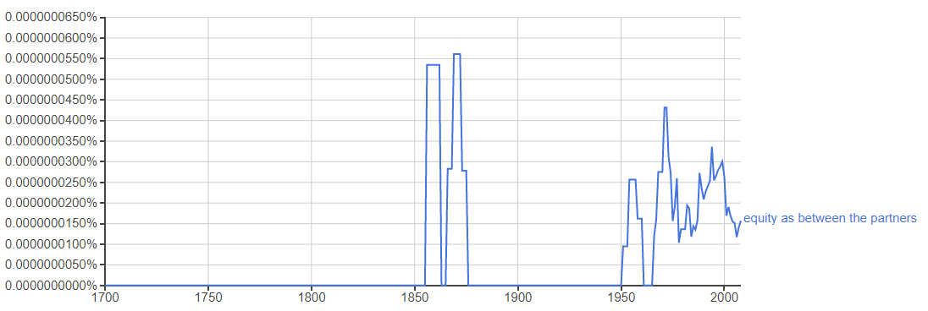
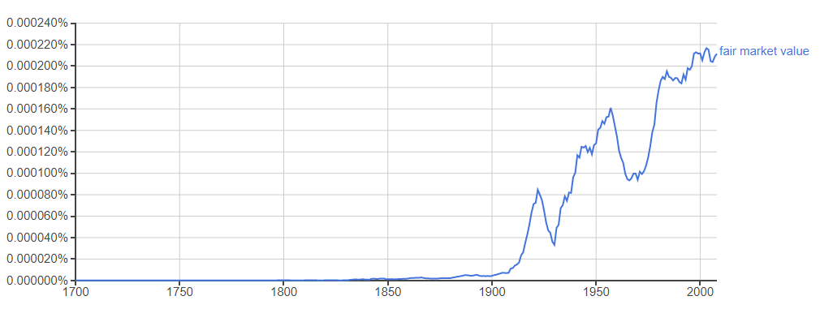
当事者間衡平価値 equity as between the partners
Ngram Viewer

Slide 2
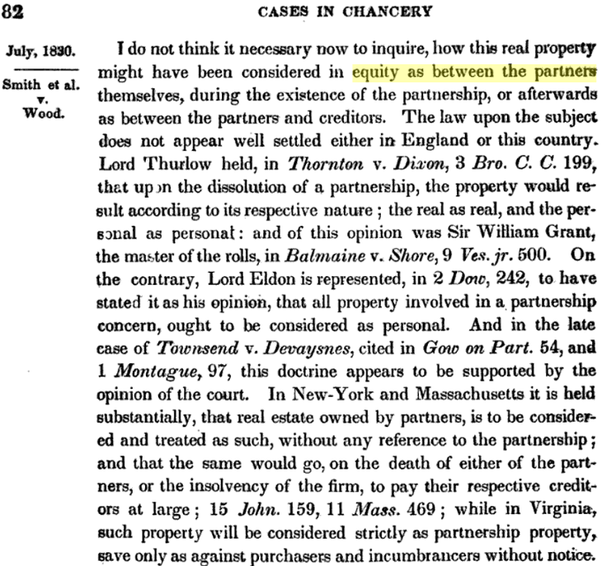
New Jersey Equity Reports, Volume 1 By New Jersey. Court of Chancery

